Slide 1
External Environment
Micro Perspective

Slide 2

External Environment
The external environment comprises all the external forces and conditions that affect an organization's strategic decisions and performance. These factors exist outside the organization and are generally beyond its control, though the organization must respond and adapt to them to survive and thrive.
The external environment constitutes factors and forces which are external to the business and over which the marketer has little or no control. The external environment is of two types:
Micro marketing environment
Macro marketing environment

Slide 3
Microenvironment
Microenvironment is also known as task environment and operating environment because its forces have a direct bearing on the operations of the firm. The microenvironment consists of the actors and forces in an organization’s immediate surroundings that affect its ability to serve its customers and operate effectively. These include the company itself, its suppliers, marketing intermediaries, customer, competitors, and various publics.
By thoroughly understanding and analyzing these components, companies can craft more effective strategies, meet customer demands more accurately, and gain a competitive edge in the market.

Slide 4
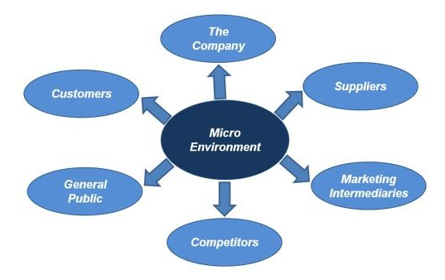

Slide 5
Component of Microenvironment
Customer: The individuals or organizations that purchase the company’s products or services. Understanding customer needs and preferences is crucial for creating effective marketing strategies. Customers are people who buy an organization’s products/services. In simple words, an organization cannot survive without customers. A consumer, on the other hand, is the ultimate user of the product/service. A successful business keeps a close watch on both customers and consumers of its products/services. It must monitor and track any changes in tastes and preferences of the consumer along with changes in the buying habits of the customer. The firm's marketing plan should aim to attract and retain customers through products that meets their "wants and needs" and excellent customer service. For instance, customer can be anyone, teenagers, young professionals, parents, seniors etc. The success of an organization depends heavily on understanding and responding to its customers' needs, preferences, and behaviors.

Slide 6
Organization: One of the most important aspects of the microenvironment of an organization is the self-analysis of the organization itself. It must understand its own strengths and weaknesses, objectives and goals of the business, and resource availability. The following non-specific elements of an organization can affect its performance:
Owners: People who have a major shareholding in the organization and have vested interests in the well-being of the company.
Board of Directors: The board of directors is elected by the shareholders for overseeing the general management of the business and ensuring that the shareholder’s interests are met.
Employees: People who work in the organization are major contributors to its success. It is important that all employees embrace the organization’s goals and objectives.

Slide 7
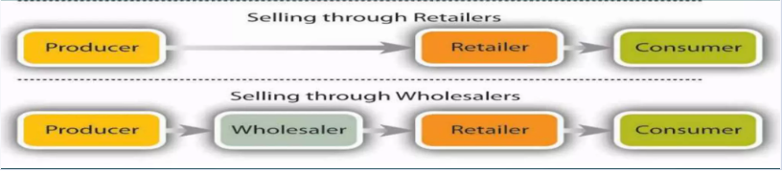
Market Intermediaries: The marketing intermediaries are also an important component for company’s overall value delivery network. They include those individuals or firms who help the company in promotion, sales and distribution of its goods to the final buyers. For instance, middlemen (agents or merchants) who help the company find customers, physical distribution firms such as warehouses or transportation firms that help the company in stocking and moving goods from their origin to the destination and marketing service agencies such as market research and advertising firms. The marketing intermediaries include intermediaries for the company to find customer or close sale with them.
Some important issues are:
The cost structure of the market
Price Sensitivity of the market
Technological structure of the market
The existing distribution system of the market
The maturity of the market

Slide 8

Competitor: Every business has competition. Competitors are other organizations that compete for both resources and markets. Hence, it is important that an organization is aware of its competitors and in a position to analyze threats from its competition. A business must be aware of its competitors, their strengths and weaknesses, and the most aggressive and powerful competitors always. Further, an organization can have direct or indirect competitors. When organizations are involved in the same business activity, they compete for both resource and market. This is Direct Competition.

Slide 9
Let us consider a coffee shop chain called “ABC Café," which operates in a competitive urban market. The company’s success hinges on its ability to understand and respond to the competitive landscape.
Direct Competitors:
Local Coffee Shops: Independent cafes that offer unique, artisanal coffee experiences. They may have a strong local following and emphasize community engagement and high-quality, locally sourced ingredients.
Large Coffee Chains: Major brands like Starbucks and Costa Coffee that dominate the market with extensive resources, brand recognition, and a wide range of products.
Specialty Cafes: Niche players that focus on specific aspects like organic coffee, single-origin beans, or vegan-friendly options.
Indirect Competitors:
Fast Food Restaurants: Chains like McDonald's and Dunkin' that offer coffee as part of their broader menu.
Convenience Stores and Supermarkets: Places where customers can purchase ready-to-drink coffee or coffee beans.

Slide 10
Supplier: Suppliers are another important component of the microenvironment. Organizations depend on many suppliers for equipment, raw material, etc. to maintain their production. Suppliers can influence the cost structure of the industry and are hence a major force.
A supplier is a group that provides raw materials and other inputs required for the bulk manufacture of products. Any business in good shape has a strong symbiotic relationship between the organization and its suppliers. Thus, the healthy and amicable relationship benefits both entities for their existence. It can also be understood by the incident where a firm falls short of raw materials and the whole production and supply process gets delayed.
In terms of suppliers, the company could consider obtaining the essential materials or labor under its manufacturing schedule. It can put in place a purchasing policy that offers it bargaining power.

Slide 11
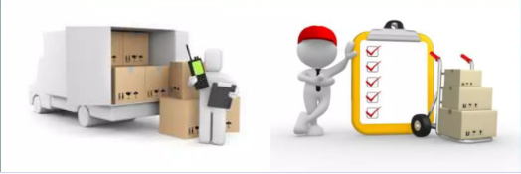

The company should develop specification searching the potential suppliers, electing the suppliers who can supply the best mix of quantity, quality, credit facility, warranties and low price. Excellent suppliers make it possible for you to create and distribute your products and services, which is critical to your company’s long-term growth.

Slide 12
Public: The public refers to the group of people who have an actual or potential interest in company’s product or who can have an impact on the organizations ability to achieve its objective. There are seven types of publics identified in a company’s marketing environment which includes financial publics, media publics, government publics, citizen-action publics, internal publics, local publics and general public.
Financial Public:
Banks, investors, brokerage firms, stockholders etc.
Affect a company’s ability to take loans, favorable payment terms etc.
They also determine how the customers or other publics perceive a business.
Media Public:
Newsletters, articles, blogs, magazines, radio announcements etc.
To make a perception about a business in the minds.
Having good media relations can always help a company hide its faults and highlight its strengths.
But if the media relations are not good, it might lead to heavy losses.

Slide 13
Government public:
The Government rules and regulations need to be followed while operating a business.
Management must take government developments into account.
A business should always be updated about the Government policies.
Citizen action public:
A company’s marketing decisions may be questioned by consumer organizations.
Include consumer, minority, and environmental groups.
These are the voluntarily or involuntarily formed public groups for the benefit of the general consumer.

Slide 14
Internal public:
A company’s employees, managers, distributors, suppliers, volunteers, stakeholders, Board of Directors etc. are very important assets of a company.
If the internal public is happy and content, then only they will try to increase the good will of the company, in the outside world.
They can also be used to inform the employees about the new advancements in the company.
Local public:
General public includes the general customers.
The customers brand perception is very important for the company’s success.
concerns about the company's products and actions.
General public:
These include the neighborhood citizens and community organizations.
A community relations officer needs to be appointed to solve the issues of the local public.

Slide 15

Thank you

